Slide 1
Docking Port Detection in 3-D Space
LeTeam: Neil Ghugare, Nishanth Kunchala,
Pranav Moola, Jacob Balek

Slide 2
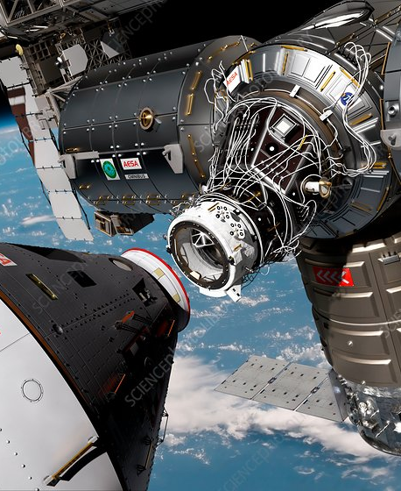
Our Purpose
Create an open-source docking system that can be generalized for different spacecraft.
Aid in the flight process of docking capsules to space stations.
Credit NASA / WALTER MYERS / SCIENCE PHOTO LIBRARY
Notes:
Nish

Slide 3
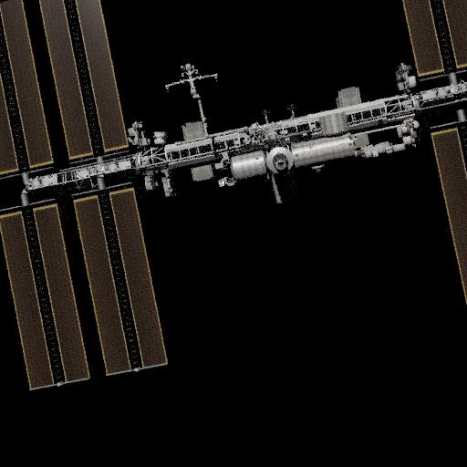
Our Data
10,000 images of ISS and docking port
Pre Labeled with distance to ISS, and (x,y) coordinates of the docking port
Part of AICrowd challenge
Notes:
Pranav

Slide 4
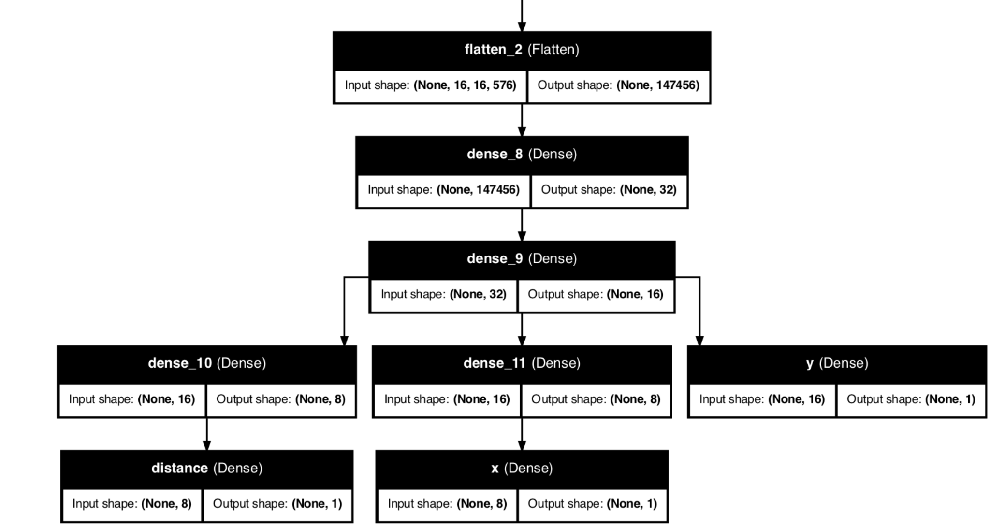
Our Model
Multi-Headed Network
MobileNetv3Small
Heads
1) Distance
2) X-coordinate
3) Y-coordinate
Notes:
Neil

Slide 5
Challenges
Solutions
Loss Landscape: local minima
Gradient Descent
Minimizing only two/three dimensions
Model Complexity
Overfitting
Visualizing 3D in 2D space
Optimizers
Momentum-based
Dynamically Weighted Loss Function
Tuning Learning Rate
Weighted Sum
Moving camera in 3D Plot
Notes:
Jacob

Slide 6
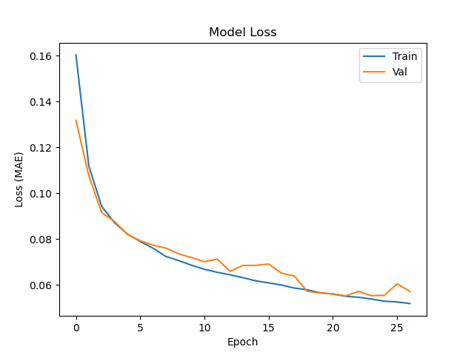
Loss | Total | Distance | X | Y
Train | 0.0518 | 0.0411 | 0.0086 | 0.0021
Test | 0.0574 | 0.0454 | 0.0095 | 0.0025
Notes:
Neil

Slide 7
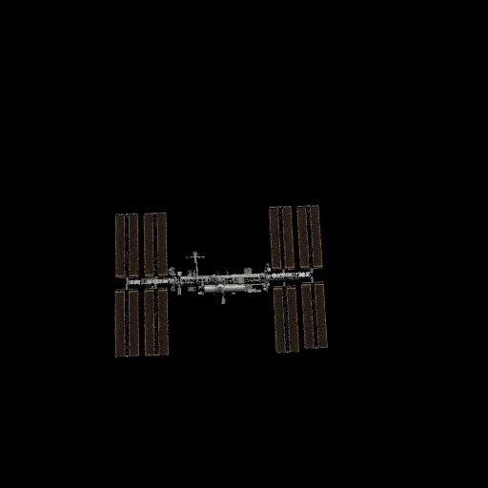
Notes:
Nish

Slide 8
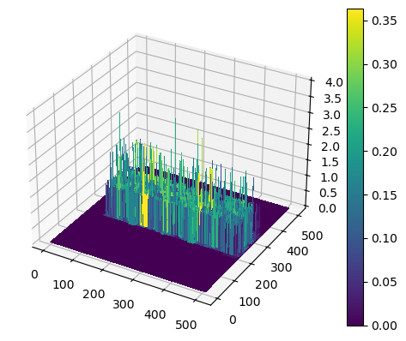
Future Directions
Consider using polar coordinates instead of cartesian
Augment data to address spread in x
Rotate ISS and transform docking port location
Show movement of shuttle in visualization
Notes:
Pranav

Slide 9
Credits
Dataset: https://www.kaggle.com/datasets/msafi04/iss-docking-dataset/data
STL of ISS: https://www.thingiverse.com/thing:3570393#google_vignette
STL of Dragon Shuttle: https://www.thingiverse.com/thing:4207259
Notes:
Nish

